Slide 1
Chapter 16
How to organize, document, and test your classes

Slide 2
Objectives
Applied
Add XML documentation to your classes.
Create and use a class library.
Use unit testing to test your classes and class libraries.
Knowledge
Describe two ways that you can code two or more classes in a single file.
Describe the benefits of creating and using a class library.
Describe the use of namespaces.
Describe the use of partial classes.
Describe the advantages of unit testing.
Describe the AAA pattern that’s commonly used with unit testing.

Slide 3
A file with two classes coded one after the other
public class Class1
{
// Body of Class1
}
public class Class2
{
// Body of Class2
}

Slide 4
A file with nested classes
public class OuterClass
{
InnerClass ic = new InnerClass();
// code that uses the inner class
// Body of OuterClass
public class InnerClass
{
// Body of InnerClass
}
}

Slide 5
A Customer class that’s split into two files
The first file
public partial class Customer
{
// Some members of the Customer class
}
The second file
public partial class Customer
{
// The rest of the members of the Customer class
}

Slide 6
A Form class that’s split into two files
The Form1.cs file
public partial class Form1 : Form
{
// The code for the Form1 class that's added
// by the programmer
}
The Form1.designer.cs file
partial class Form1
{
// The code for the Form1 class that's generated
// by Visual Studio
}

Slide 7
Code that declares a namespace
namespace ProductMaintenance
{
public partial class Form1 : Form
{
// Body of Form1 class
}
}

Slide 8
Code that declares nested namespaces
namespace Murach
{
namespace Validation
{
// Body of Validation namespace
}
}
Another way to nest namespaces
namespace Murach.Validation
{
// Body of Validation namespace
}
A using directive that specifies a namespace
using Murach.Validation;

Slide 9
Part of a Validator class with XML documentation (part 1)
/// <summary>
/// Provides static methods for validating data.
/// </summary>
public static class Validator
{
/// <summary>
/// The character sequence to terminate each line
/// in the validation message.
/// </summary>
public static string LineEnd { get; set; } = "\n";

Slide 10
Part of a Validator class with XML documentation (part 2)
/// <summary>
/// Checks whether the user entered a value.
/// </summary>
/// <param name="value">The value to be validated.</param>
/// <param name="name">A name that identifies the value
/// to be validated.</param>
/// <returns>An error message if the user didn't enter
/// a value.</returns>
public static string IsPresent(string value, string name)
{
string msg = "";
if (value == "")
{
msg += name + " is a required field." + LineEnd;
}
return msg;
}

Slide 11
XML elements for class documentation
Element Description
<summary> Provides a general description of a class, property, method, or other element.
<value> Describes the value of a property.
<returns> Describes the return value of a method.
<param name="name"> Describes a parameter of a method.

Slide 12
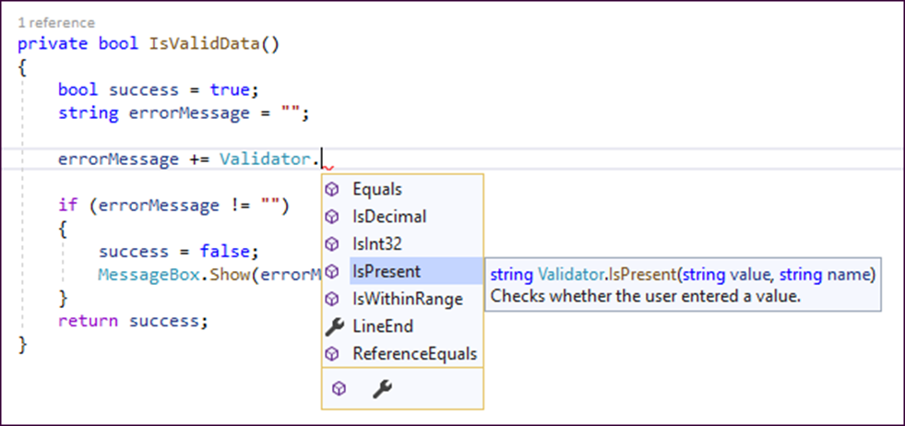
A screen tip with documentation for a method

Slide 13
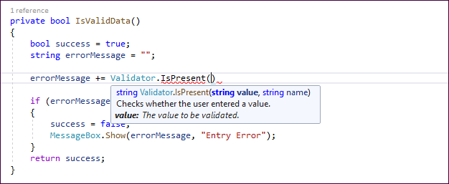
A screen tip with documentation for a parameter

Slide 14
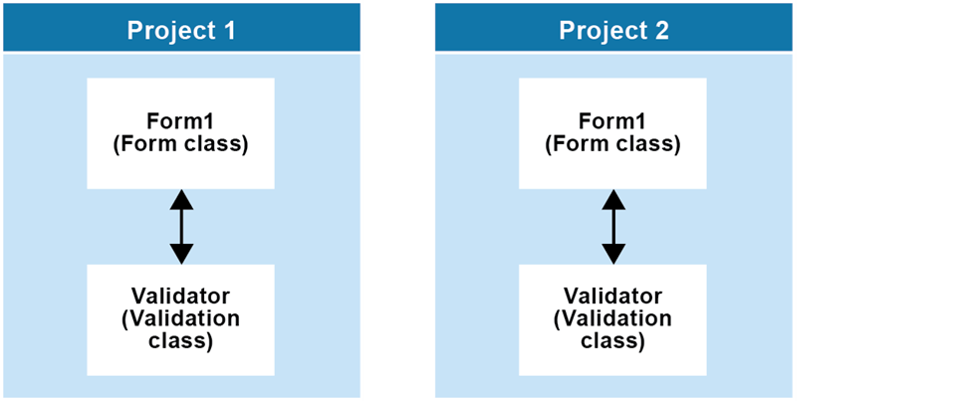
Two projects that use the Validator class

Slide 15
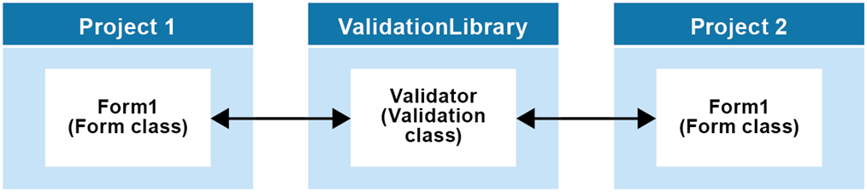
Two projects that access the Validator class via a class library

Slide 16
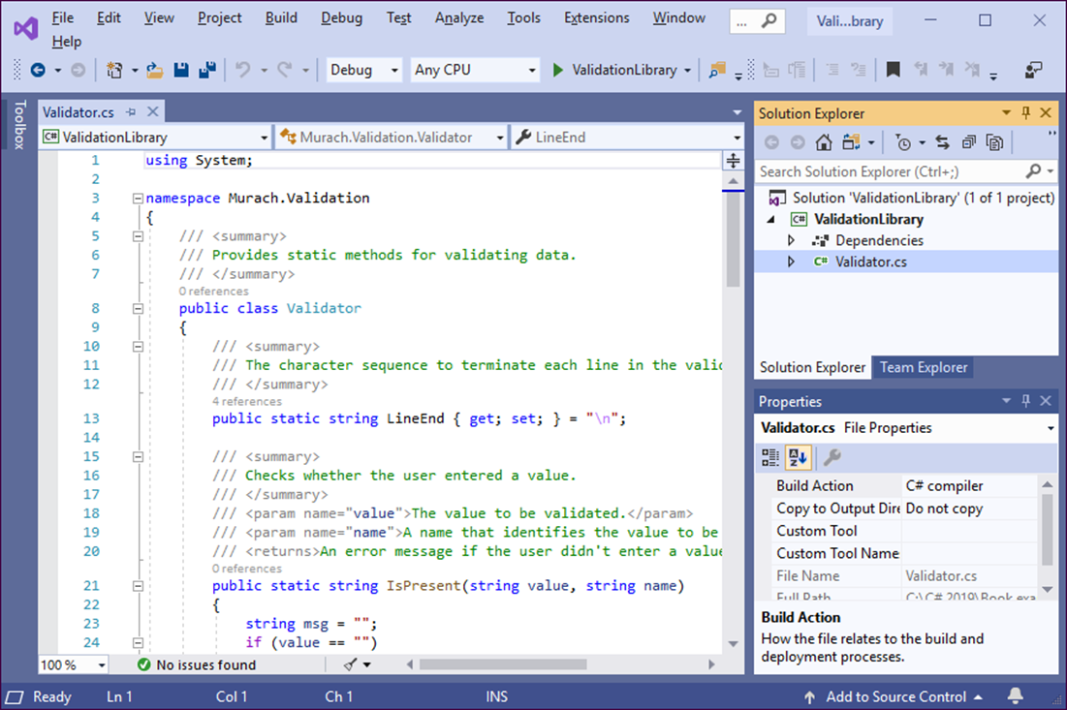
A class library project

Slide 17
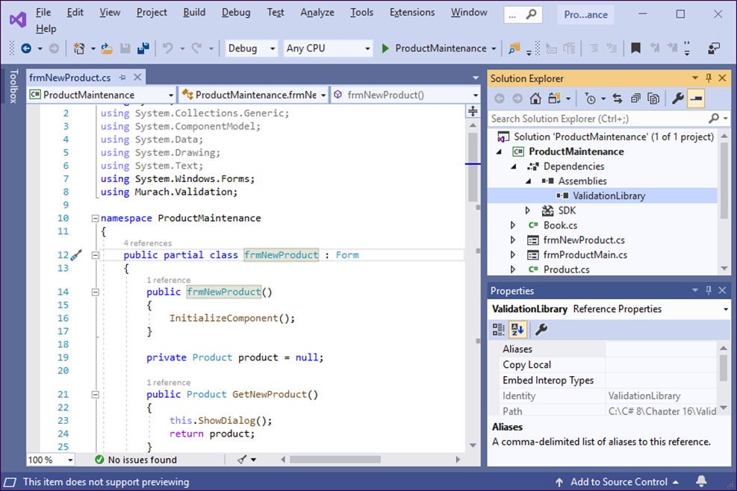
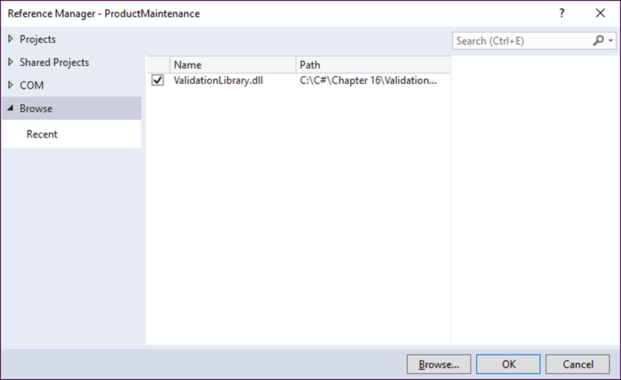
A project with a reference to a class library

Slide 18
A using directive for the validation class library
using Murach.Validation;

Slide 19
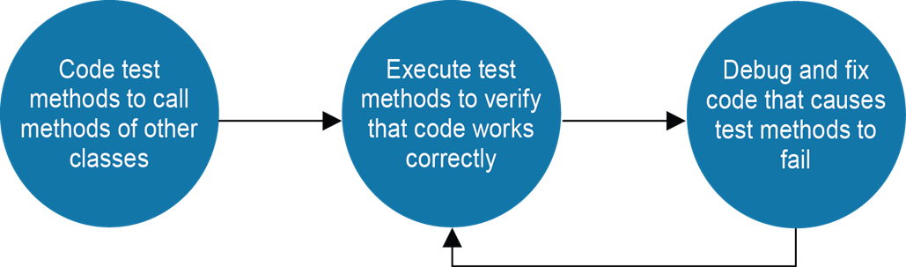
The unit testing process

Slide 20
Advantages of using unit tests
Unit testing helps you find problems earlier in the development cycle than would be possible if you tested all your methods manually.
You can run the unit tests for a class each time you change it to quickly detect any problems that were introduced.
You can develop and test an application more quickly because you don’t have to run the application and retest it each time you change the code. Instead, you can use unit tests to test just the code that was changed without running the application.
Unit testing makes debugging easier because when a test fails, you only need to debug the most recent code changes.

Slide 21
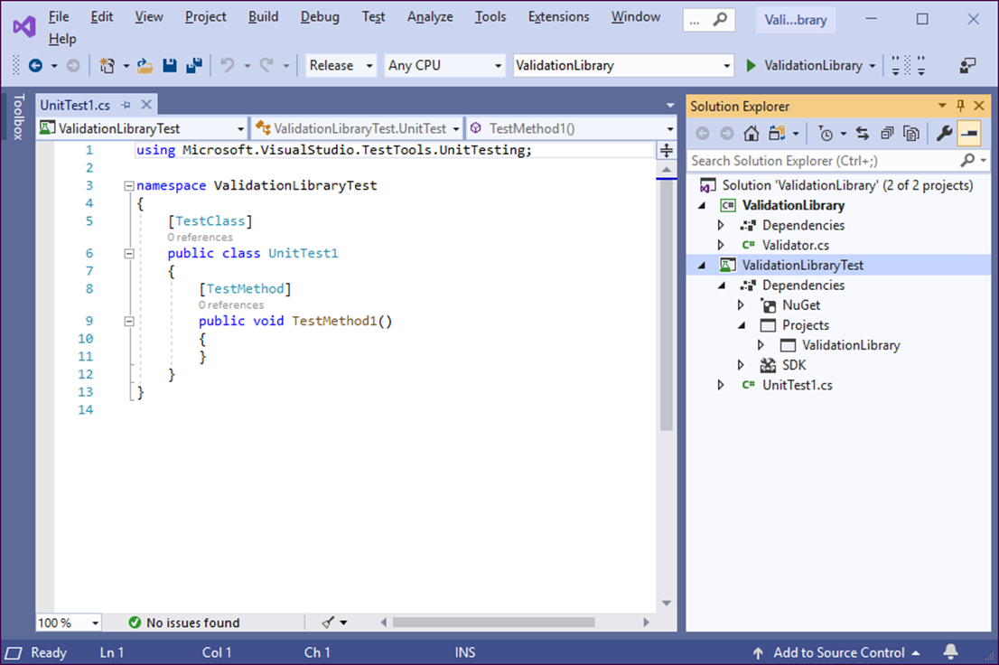
A Visual Studio solution with a unit test project

Slide 22
How to create a unit test project
To add a unit test project to a solution, right-click on the solution in the Solution Explorer and select Add→New Project to display the Create a New Project window.
Select the MSTest Test Project (.NET Core) template, and press the Next button to display the Configure Your New Project window.
Enter a name for the project. The location will default to the folder for the current solution, which is usually what you want.

Slide 23
Common static methods of the Assert class
Method Description
AreEqual(expected, actual) Tests whether the actual object is equal to the expected object and throws an exception if the two objects are not equal.
AreNotEqual(expected, actual) Tests whether the actual object is equal to the expected object and throws an exception if the two objects are not equal.
IsFalse(booleanExpression) Tests whether the Boolean expression is false and throws an exception if it is true.
IsTrue(booleanExpression) Tests whether the Boolean expression is true and throws an exception if it is false.

Slide 24
A using directive for the class being tested
using Murach.Validation;
Unit tests for the Validator class
[TestClass]
public class ValidatorTest
{
[TestMethod]
public void IsDecimal_ValidValue()
{
string expected = ""; // arrange
var result = Validator.IsDecimal("3.14", "Name"); // act
Assert.AreEqual(expected, result); // assert
}
[TestMethod]
public void IsDecimal_InvalidValue()
{
string name = "Test field"; // arrange
var result = Validator.IsDecimal("three", name); // act
Assert.IsTrue(result.Contains(name)); // assert
}
.
.
}

Slide 25
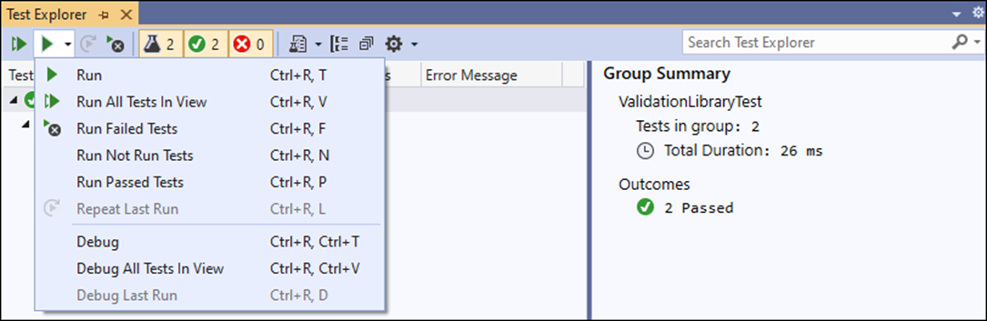
The Test Explorer window before the tests are run

Slide 26
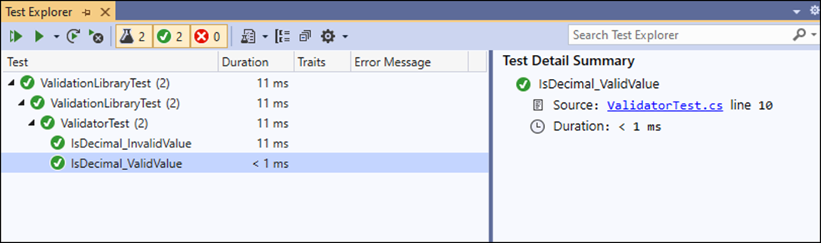
The Test Explorer window with the results of a test run

Slide 27
Objectives
Applied
Add XML documentation to your classes.
Create and use a class library.
Use unit testing to test your classes and class libraries.
Knowledge
Describe two ways that you can code two or more classes in a single file.
Describe the benefits of creating and using a class library.
Describe the use of namespaces.
Describe the use of partial classes.
Describe the advantages of unit testing.
Describe the AAA pattern that’s commonly used with unit testing.

